Slide 1

Database Architecture
Daria Dubovskaia

Slide 2



Agenda
What Is the Database Architecture?
Tiers
Normalization
DBMS

Slide 3

What Is the Database Architecture?

Slide 4

Database Architecture involves:
The application of programming languages to design software.
The design, implementation, development, and maintenance of the computer programs that store and manage data for businesses
The design of a DBMS (centralized, decentralized, hierarchical)

Slide 5
Tiers

Slide 6

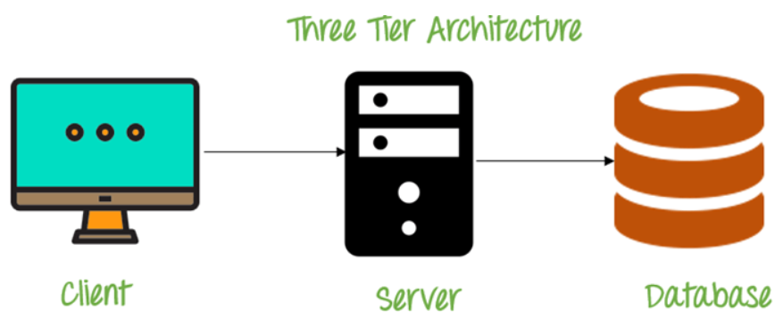
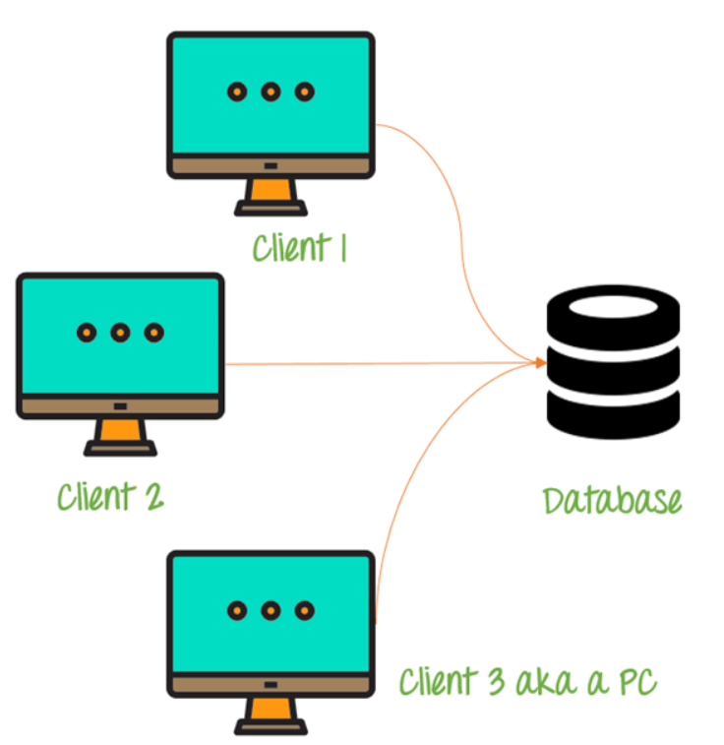
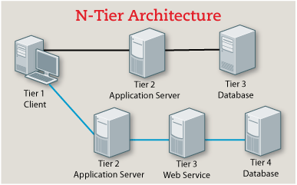
1-tier architecture
3-tier architecture
2-tier architecture
n-tier architecture

Slide 7
Normalization

Slide 8
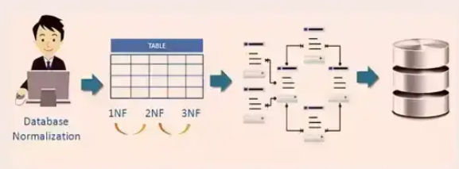
Normalization is Used to:
Organize the data in the database
Decompose tables to eliminate data redundancy
Put the data into tabular form by removing duplicated data from the relation tables
Eliminate redundant data
Ensure data dependencies make sense

Slide 9
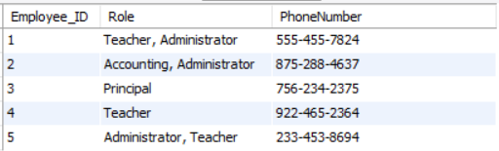
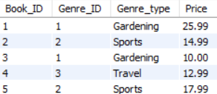
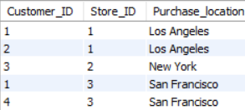
Normalization rules
1st Normal Form:
3rd Normal Form:
2nd Normal Form:

Slide 10
Database Management System

Slide 11
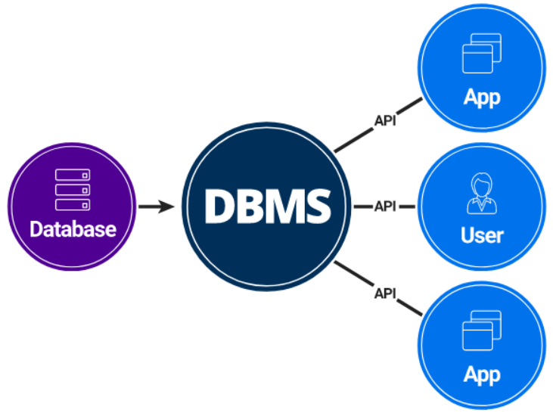
DMBS is used to
Examples
Helps manage a database
Find and store information within a database
Add a layer of security to the database.
Store data in a neater way and hence, more data can be stored
Microsoft SQL Server
Oracle Database
MySQL
PostgreSQL
MongoDB

Slide 12

Conclusion
We learned the concepts of Database Management Systems, three types of database architecture.
It helps in design, development, implementation, and maintenance of a database.
Professionals use the organized data to facilitate improved and effective decision-making.
With the changes in the approaches of technology, advancements in automation, and the cloud are driving data organization in new directions.

Slide 13


Thank You

Slide 14
Resources
N-tier architecture style
Anomalies in Relational Model
Types Of NoSQL Database Management
Differentiate Database system and DBMS
Normalization In DBMS
Third Normal Form (3NF)

